Slide 1
Episode 6: Collaboration & Engagement

Slide 2
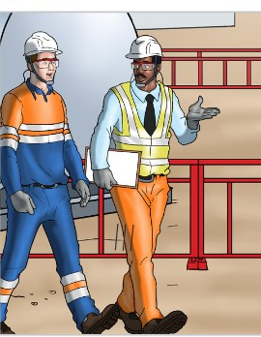

COLLABORATION & ENGAGEMENT
What is ENGAGEMENT?
Engaging employees in safety means getting them to believe, participate and willingly contribute to its success. Create safety with their actions.
Engagement means moving beyond the mindset of involvement or “do as you're told to do” to engaging employees to “help us create a culture of safety excellence”
All begins with the question: “how can I help YOU to work safely ? ”

Slide 3
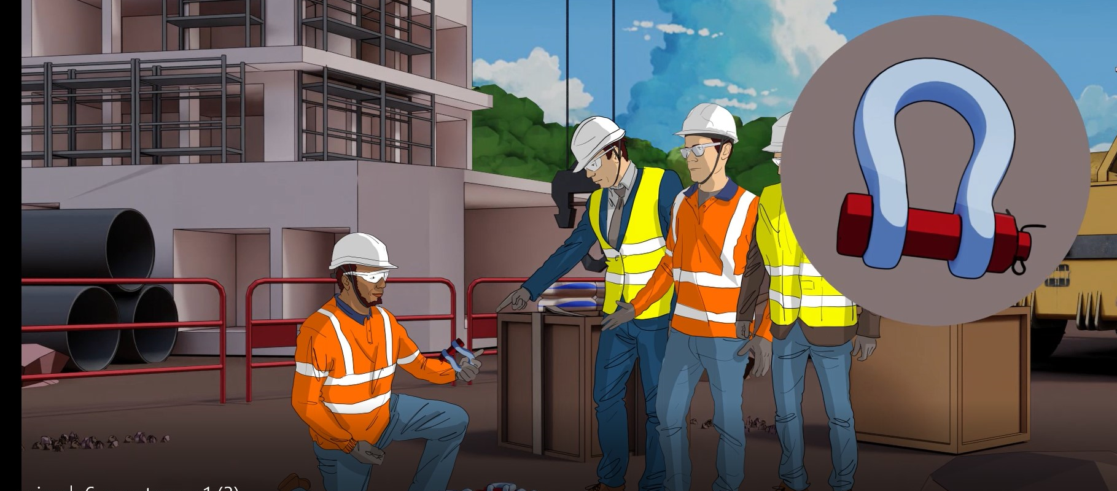
COLLABORATION & ENGAGEMENT
Managers should practice ENGAGEMENT
What you show interest in, is what is important!
DON’T WALK BY! SHOW YOUR INTEREST
Get out of your office and ask a lot of questions about safety. Every time you ask about efficiency and
effectiveness, add the work “SAFELY.”
For example: “How long is it going to take to
SAFELY sling this load?”

Slide 4
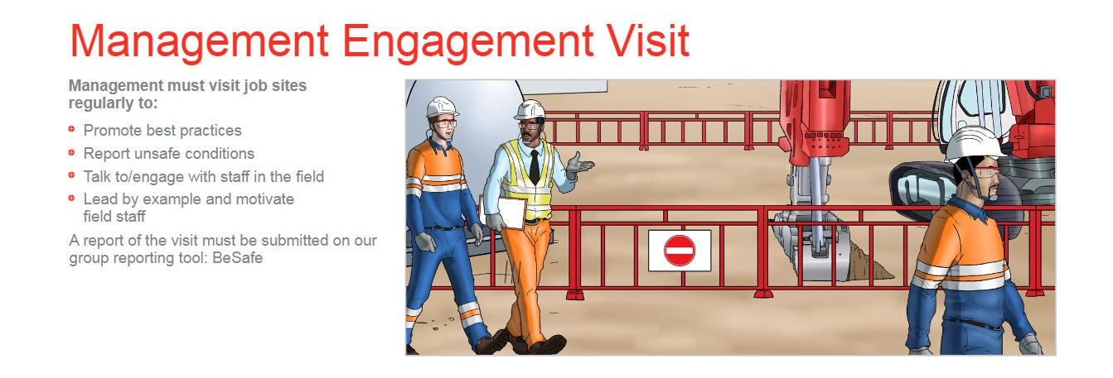
COLLABORATION & ENGAGEMENT

Slide 5
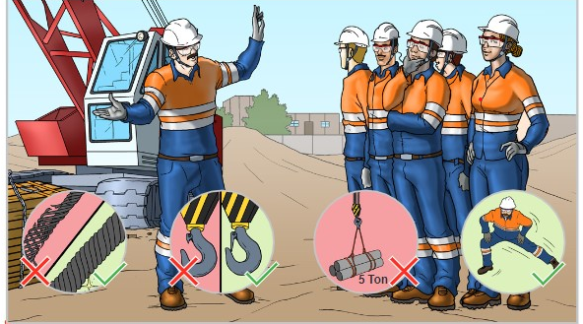
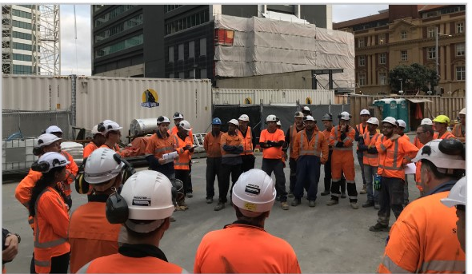
COLLABORATION & ENGAGEMENT
Managers should practice ENGAGEMENT
Find SOLUTIONS TOGETHER! Every project is different ,every task is specific: let everyone express their concerns.

