Slide 1
Episode 1: DRIVING SAFETY

Slide 2
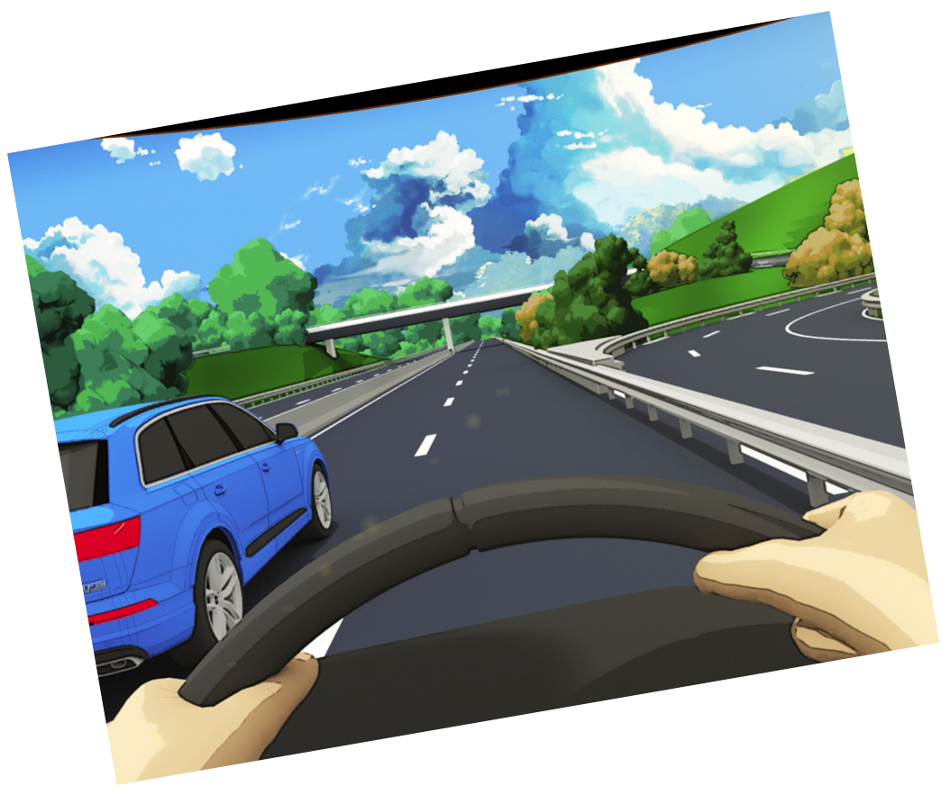
Safety is something that drivers should always keep in mind. When you are operating a vehicle for business or personal purposes, you have a responsibility to do your part to keep the road safe for yourself, other drivers, passengers, and the public.
Soletanche Freyssinet Health & Safety Common Rules requires the commitment of each BU to implement a driving safety programme:
“ Rule N.3.10: Each BU will implement a Driving Safety Programme including assessment, training and monitoring for company drivers and for employees driving a company vehicle. The BU or project providing collective transportation for their employees (i.e. bus, minibus, pick-up trucks) will ensure that vehicles are well maintained at all times and fitted with seatbelts »
In 2016 we have launched the Soletanche Freyssinet Driver Risk Management Programme with the objective to assess the risk exposure of our company drivers and personnel routinely driving long hours:
DriverMetrics - https://www.driverriskindex.co.uk/?client=1144&auth=fcdd
contact@drivermetrics.com

Slide 3
Driving safety is not just about rules and regulations… What can YOU do to improve safety on the road?
Plan your trip ahead (time of departure, select the itinerary, vehicle inspection, etc.)
Talk to your collegues or your supervisor if you are not fit for driving (fatigue, health conditions)
Do not drive under the influence of alcohol!
Speak up if your driver is not in the condition to drive you safely (alcohol or drugs abuse)
Report to your supervisor/manager any unsafe situations you have observed while driving
Take a break when driving at least every 2 hours
Consider sharing a long trip with your colleagues
Verify all your passengers are safe in the vehicle (seatbelts)
Look out for each other, before, during and after driving!

