Slide 1
Episode 2: LONE WORKING

Slide 2
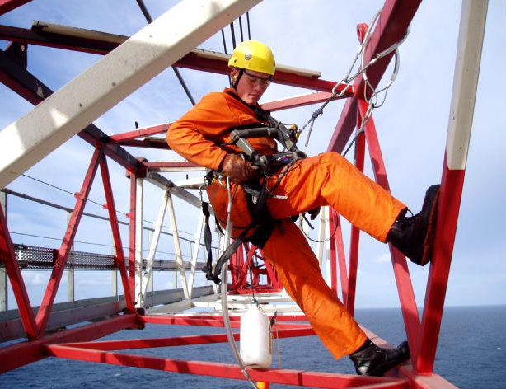
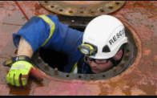
What is LONE WORKING?
You're a LONE WORKER if you work by yourself without close or direct supervision.
A huge number of jobs can require people to be left alone and isolated and, while many of the hazards that lone workers face are similar to those faced by other workers, the risks involved may be greater because the worker is on their own.
Work at height Confined space Operating Plant & Equipment
All begins with the question: “can I do this alone safely? ”

Slide 3
LONE but NOT ALONE: stay prepared!
DO DON’T
Let your team mates know your whereabouts
Complete a risk assessment
Follow relevant safety rules and guidelines
Carry a personal safety alarm or other communication device
Don’t be complacent and assume you are safe
Don’t take unnecessary risks
STOP: speak up if you have doubts about your safety

Slide 4
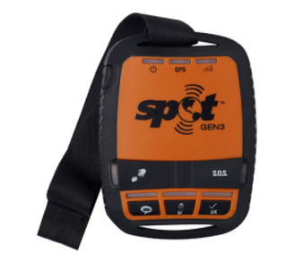
Lone working devices
Lone worker safety devices have become increasingly popular as a way to monitor lone workers’ safety. These devices have been specifically designed to protect you from the challenges that come with working alone.
Wide range of products available on the market:
Walky-talkies Built-in GPS, a fall detection alert and a dedicated panic alarm.

Slide 5
Lone Working - resources at your disposal
Protecting lone workers: How to manage the risks of working alone (Health & Safety Executive, UK – English only)

