Slide 1
Episode 5: Subcontractors’ Management

Slide 2
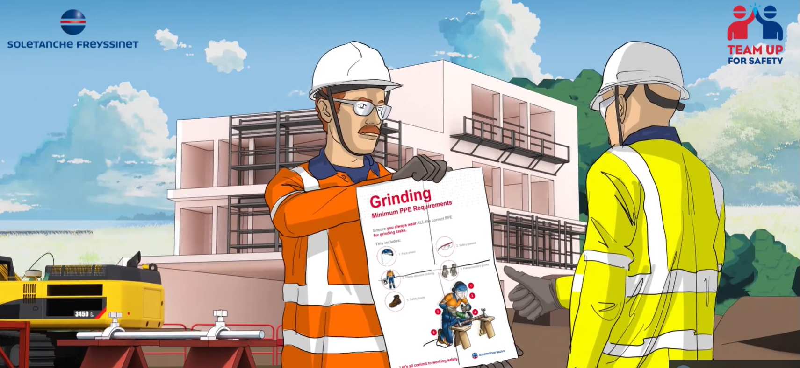

Managing Subcontractors
A subcontractor is a company or person hired to perform a specific task as part of an overall project.
Subcontractors are often operating on our job sites. The are specialized and often we do not master, or we are not familiar with their activities. They might have different company cultures and do not share our values
All begins with the question: “how can we improve subcontractors’ safety management? How can we support and involve them?”

Slide 3
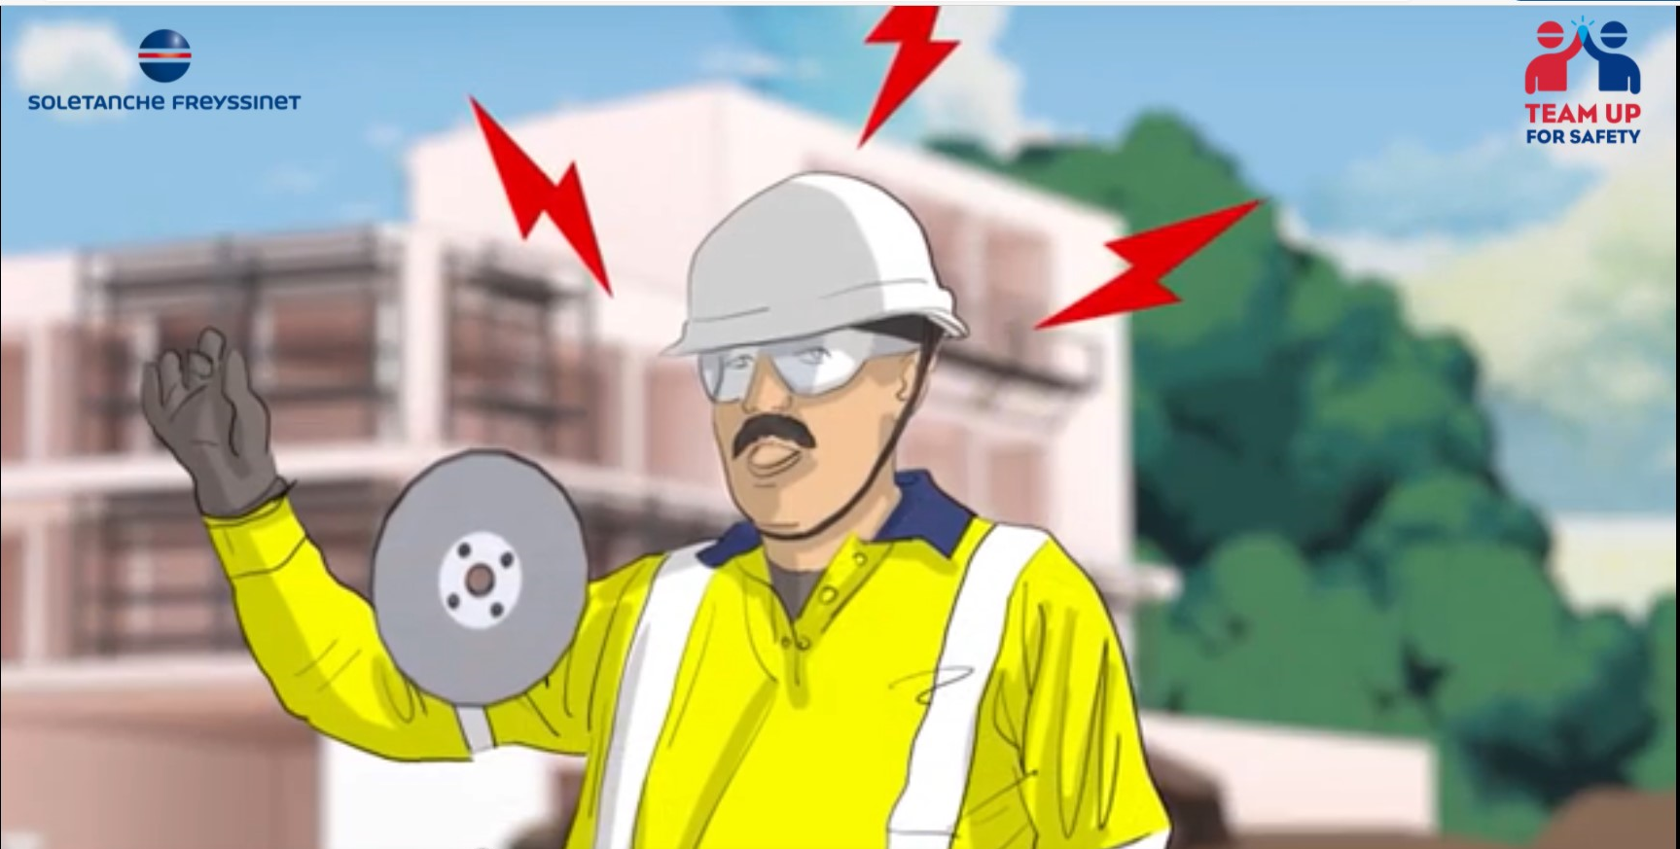
Managing Subcontractors
THE FACTS
10% of global accidents were involving Subcontractors workers
2 of the 5 fatal accidents occurred in 2020/2021 were involving subcontractors

Slide 4
Managing Subcontractors
How do you manage your subcontractors’ safety?
At the commercial stage
Most importantly…during the works: we must lead, support, control, assess them ON SITE

Slide 5

Managing Subcontractors
General procedure: the basics
Subcontractors will be preselected based on the completion of prequalification documents which must include information on their HSE performance and standards.
Once selected, HSE clauses must be included in the contract document. Also, subcontractors will be issued with copies of our HSE Management System ( in full or only relevant elements) before starting any work on site.
Before each subcontractor commences work on a site, a kick-off meeting shall be held with subcontractors in the site office;
During initial meeting, all subcontractors will be given the list of main contractual requirements they must follow. These include:
  Attending a site induction and any other safety related training
  Managers and HSE staff attending periodic HSE progress meetings, site inspections
  Compiling weekly reports regarding all aspects of HSE and reporting all incidents
  Attending any client briefings / meetings / site inductions / training as instructed by the Project Manager / Site Safety Officer

Slide 6
Managing Subcontractors
General procedure: the basics
  5) Subcontractors required to prepare their specific method statements and risk assessments for all operations / activities prior to starting any related work;
  6) Health & Safety non conformance notifications will be issued to subcontractors who fail to comply with any health & safety requirements on site;
7) Should any subcontractor fail to comply with any HSE requirements, will take all necessary actions to ensure that the situation is addressed to prevent reoccurrence;
8) Continual or serious breaches / non-compliance with the HSE system could result in the subcontractor / supplier being removed / blacklisted from the project.

Slide 7
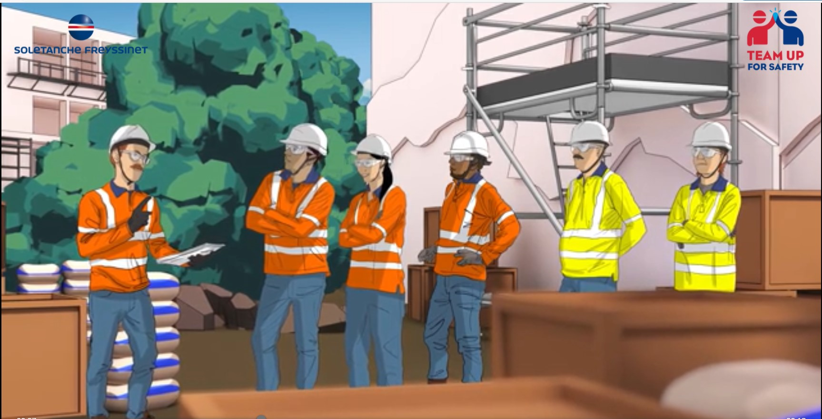
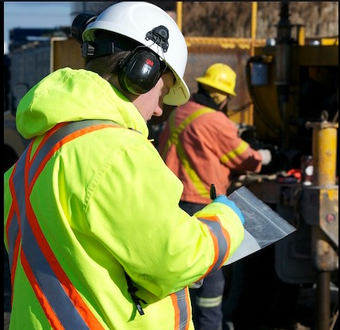
Managing Subcontractors
ON-SITE INDUCTION & PRE-START MEETINGS
All subcontractors must attend the job site safety induction prior to access the site as well as be actively involved in the daily (or shift) Pre-Start meetings
ON-SITE ASSESSMENT
The Project Manager of each job site is responsible for carrying out an assessment of the safety performance of each subcontractor
The assessment will determine whether the subcontractor need additional support and whether will remain in the list of subcontractors eligible to tender for sub-contract works from the company

Slide 8

Managing Subcontractors
In spite of all procedures, meetings and notifications, subcontractors are still getting injuried on our job sites.
Perheps the questions to add are:
Do we treat the subcontractor as one of us?
Do we care about their health and safety?
Is our safety culture mature enough to involve them?

