Slide 1
Episode 2: WORK AT HEIGHT

Slide 2
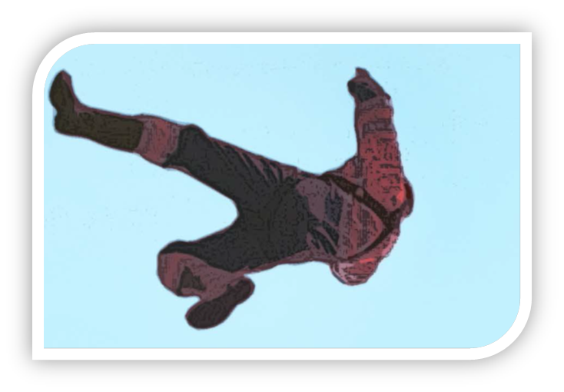
What is Work at Height?
You are working at height if you:
are working on a ladder, a flat roof, a scaffold or elevating plaftorm
could fall through a fragile surface;
could fall into an opening in a floor or a hole in the ground.
The severity of the accidents increases with the height: international standards require the use of fall protection equipment for working at height above 1.5 m.
Managing work at height follows a hierarchy of controls:
avoid,
prevent,
arrest.
All begins with the question: “can the work be done safely from the ground?”
Fall protection equipment and safety nets should only be considered as a last resort if other safety equipment cannot be used.

Slide 3
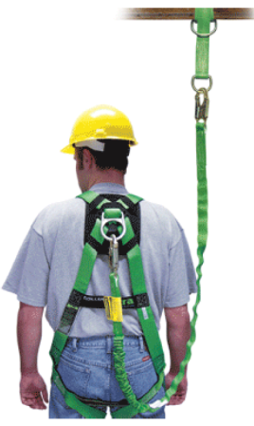
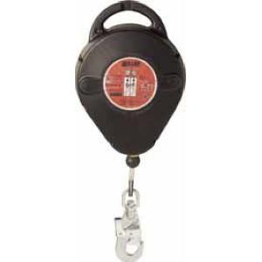
Planning your work
Before we do work at height we must always STOP and THINK:
Ensure you have a safe means of access/egress
Check if the platform you are standing on is stable, secured and fitted with collective protections
Ensure there is always a supervisor to assist you
Ensure you have all necessary fall protection and wear it correctly
DO YOU KNOW YOUR FALL PROTECTION EQUIPMENT?
Fall Arrestor
Lifeline
Safety Harness

Slide 4
Work at Height Training Program – Soletanche Freyssinet
In 2016 Soletanche Freyssinet established specialized work at heigh training centers in several countries.
Need to provide professional work at height training at SF level
SF specialized training centers are managed at regional level
A team of internal trainers has been appointed: favor internal training other than external andcreate our own program
Ensure all personnel exposed to the risk is properly trained and monitored
Do you know your closest Work at Height Training Center?

Slide 5
Work at Height- resources at your disposal
SF specialized training centers are managed at regional level
Awareness and communication resources: « Fatal second » movie
Freyssinet Safety Technical Standards – Work at Height

